Slide 1
Customer Churn Analysis in a Telecommunications Company Business Analytics Case Study Prepared by: Eliud Kigen Kipkorir
Institution:AnalystLab Africa
Tools Used:
Python
Google Colab
Pandas
Matplotlib
Seaborn
Dataset: Telco Customer Churn Dataset

Slide 2
Business Problem
Challenge
Telecommunication companies experience customer churn, which leads to:
Reduced revenue
Higher customer acquisition costs
Lower customer loyalty
Project Objective
Identify the major factors influencing customer churn and recommend strategies to improve customer retention using data analytics.

Slide 3
Dataset Overview
Telco Customer Churn Dataset
Summary
Item | Value
Records | 7,032
Variables | 21
Missing Values Removed | 11
Duplicate Records | 0

Slide 4
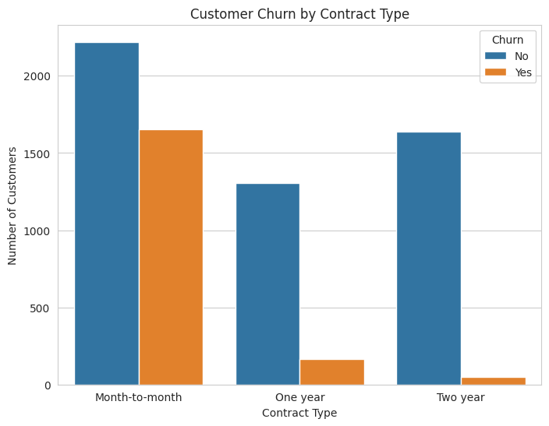
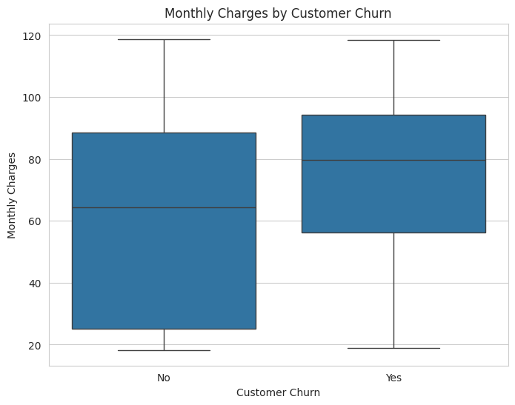
Major Factors Influencing Customer Churn
Factor | Finding
Contract Type | Month-to-month customers churn the most.
Monthly Charges | Higher-paying customers are more likely to churn.
Customer Tenure | New customers churn more frequently.
Internet Service | Fiber optic customers recorded the highest churn.

Slide 5
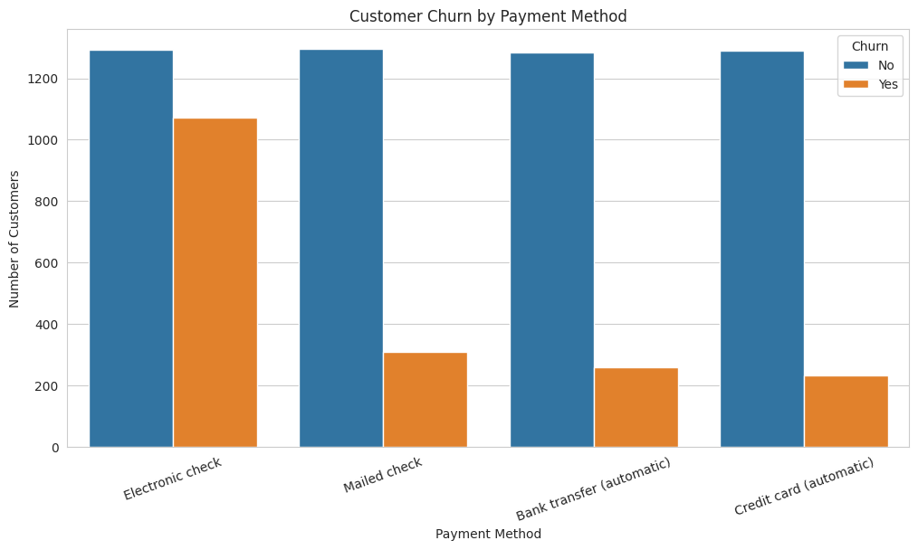
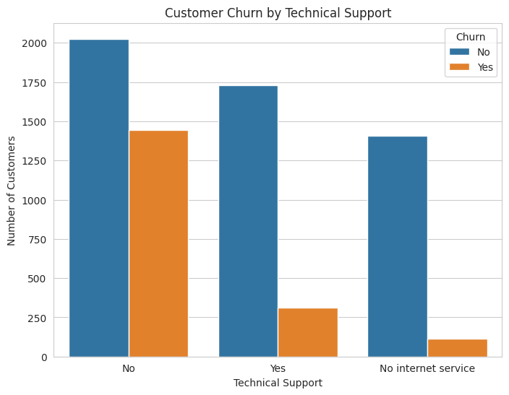
Additional Business Insights
Factor | Finding
Payment Method | Electronic check customers churn the most.
Technical Support | Customers without technical support are more likely to leave.
High-Risk Customer Profile
A customer is more likely to churn if they:
Have a month-to-month contract.
Pay higher monthly charges.
Are new to the company.
Use Fiber optic services.
Pay using Electronic Check.
Do not have Technical Support.

Slide 6
Recommendations
Encourage customers to upgrade to long-term contracts.
Review pricing strategies for high-paying customers.
Improve customer onboarding during the first year.
Investigate Fiber optic customer satisfaction.
Promote automatic payment methods and technical support services.

Slide 7
Conclusion
Key Takeaways
Customer churn is influenced by multiple business factors.
Contract type, tenure, pricing, internet service, payment method, and technical support significantly affect customer retention.
Data analytics enables organizations to identify at-risk customers and make informed business decisions.
Thank You
Questions?

